Slide 1
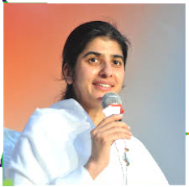
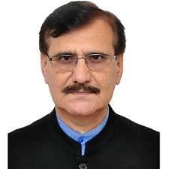
Bikaner Technical University
Live National Webinar
Speaker
Sister B K Shivani
World spiritual and motivational speaker from Brahamakumaris
July 16, 2020, 4.30pm
B K Shivani
World Spiritual University
Prof. H. D. Charan
Vice Chancellor
www.facebook.com/BTUCET
E-certificate will be provided to the students who will attend the complete session

